Slide 1

PHOTO-SCAN-SUMMARY
A web application where you upload images and it gives you a summary of the image’s content. (mage needs to have text in it)
Steps:
Input -> Upload Image → Get Image’s Text -> Summarize the image text -> Output
Using two API’s for this.
Google’s Vision API (Image to Text)
Summary API (Text to Summarized Text)
Front-End – Bootstrap / HTML / jQuery
Back-End – Node.js and Express.js.
If time permits, might try front-end with Angular.js.

Slide 2
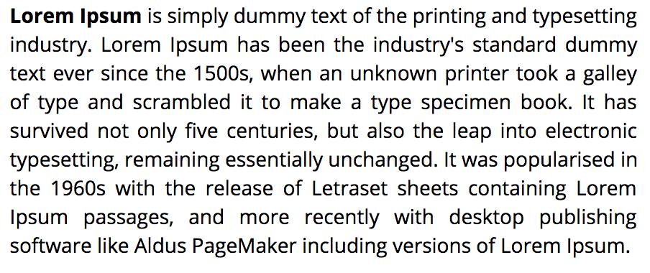
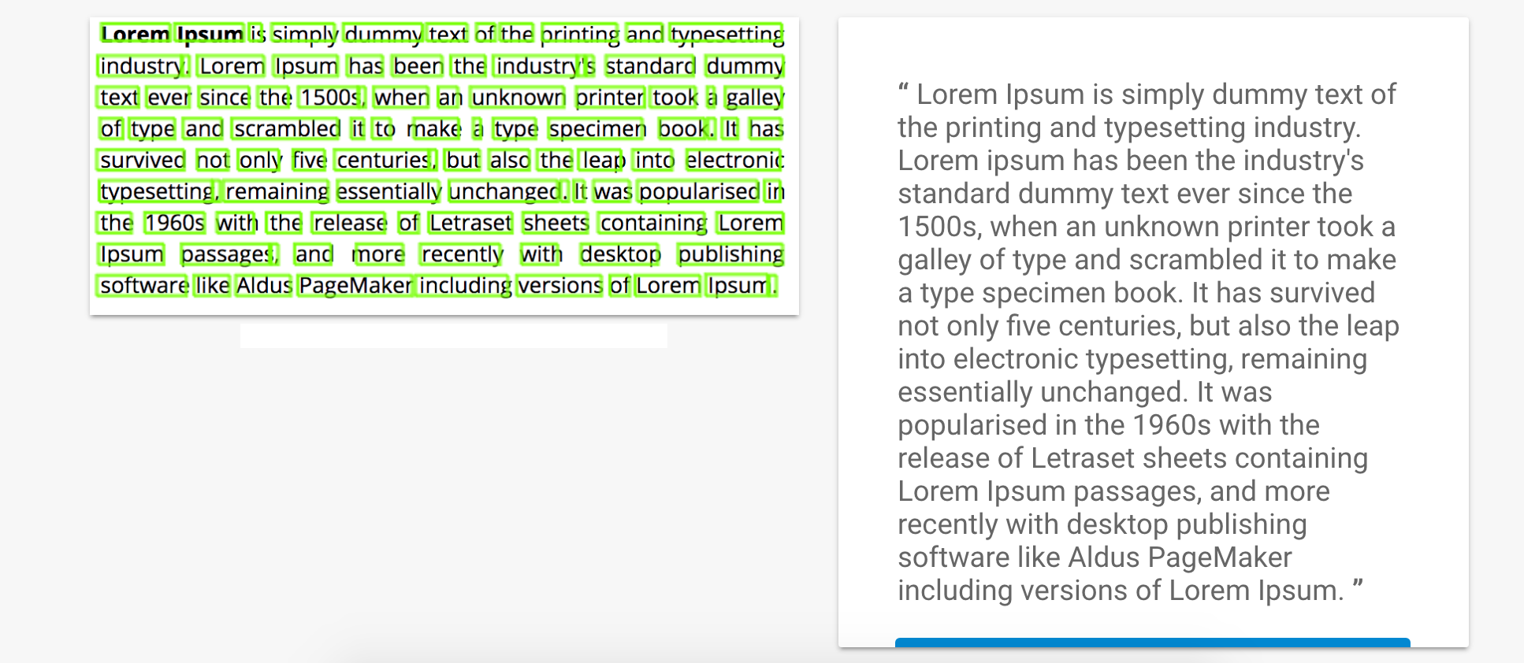
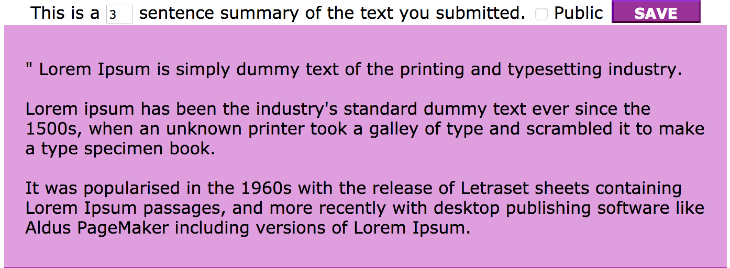
Step 1-
Input: Image
Step 2 –(Intermediate) Get Image Content
Step 3 – Get Image Content’s Summary

Slide 3
REQUIREMENTS
Core Requirements
Uploading Image and getting image content’s summary.
Optional Requirements
Giving user option to use one of the below:
Image to Text Only
Find Image category using ML.
URL summaries
PDF summaries

